Slide 1

Final Project: Healthcare Information System
John Gill

Slide 2
Code aims
This program aims to save, load, and manipulate patient and employee data within a Healthcare Information System.
It writes to .txt files in specified file paths to permanently save and retrieve data between uses of the program.
It also automatically reads from those files to load patient and employee data into AVL trees for faster data manipulation within memory. Employee AVL trees are stored within department nodes of a departments linked list that’s also constructed when the program is loaded.
The program gives the user the ability to view, add, search, and delete patients and employees from their respective AVL trees, as well as their directories from the file explorer.

Slide 3
Code aims (cont)
There is also a patient check-in “priority queue” that queues patients according to severity of illness at check in.
There are other functions related to the queue that allow the user to view the whole queue, dequeue the next patient in line, and look at the next patient in line.

Slide 4
A few clarifications
This started with reading and writing functions to directories.
Then I included AVL trees and a linked list to dynamically process patient and employee data upon automatic loading into working memory at program launch.
Then I included the queue functions.
As a result, some optimization and consistency was sacrificed for time’s sake.

Slide 5
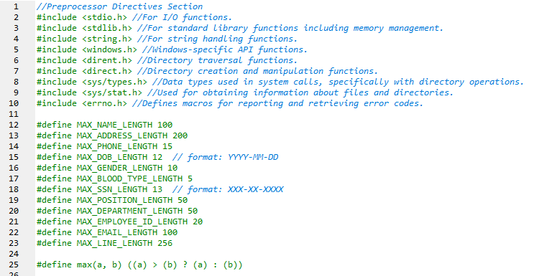
Preprocessor Directive Section

Slide 6
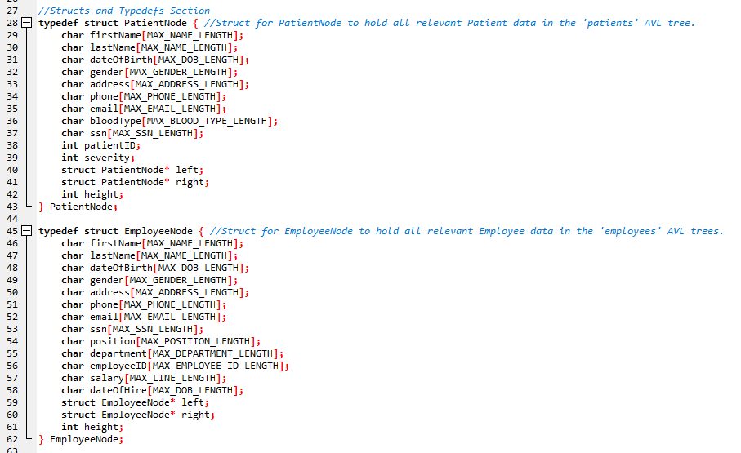
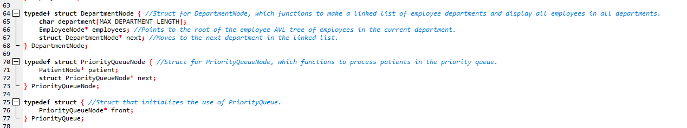
Structs and Typedefs Section

Slide 7
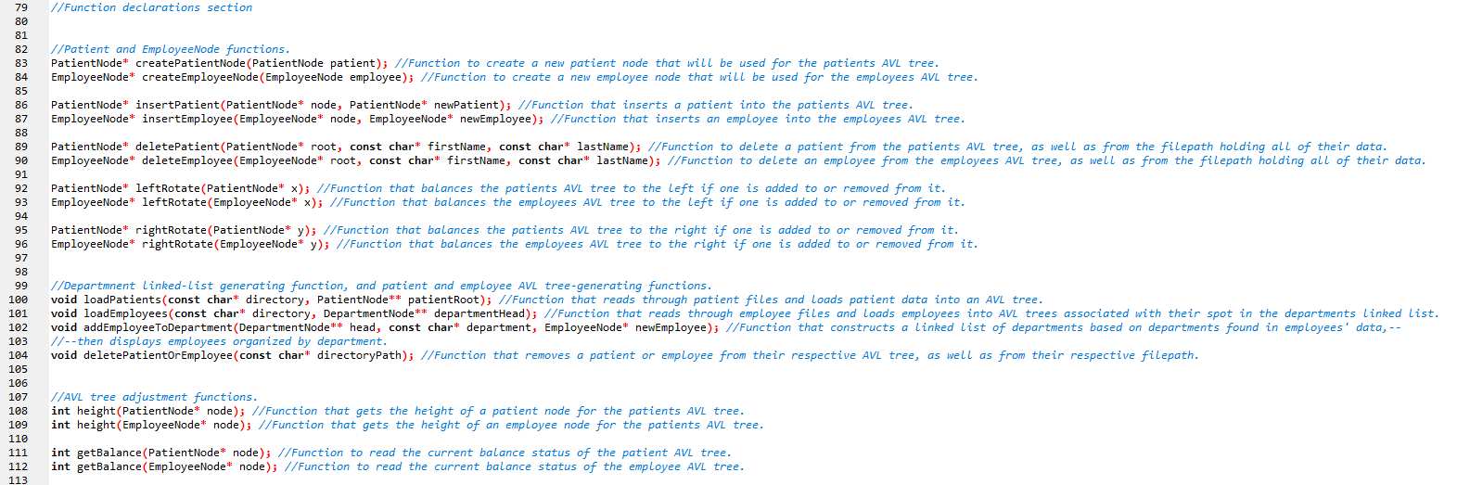
Function Declarations Section

Slide 8
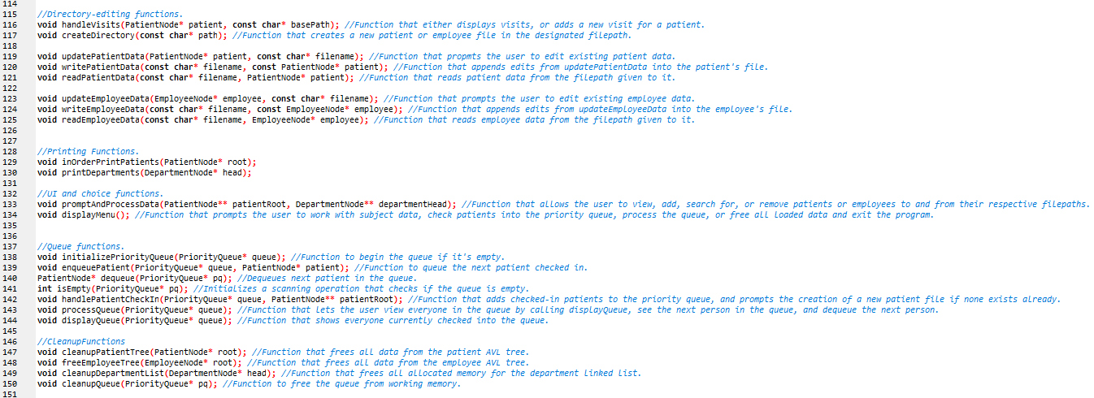
Function Declarations Section (cont)

Slide 9
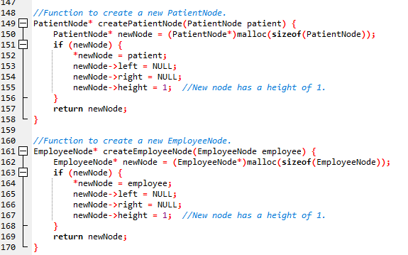
Patient and Employee AVL Tree-Generating Functions

Slide 10
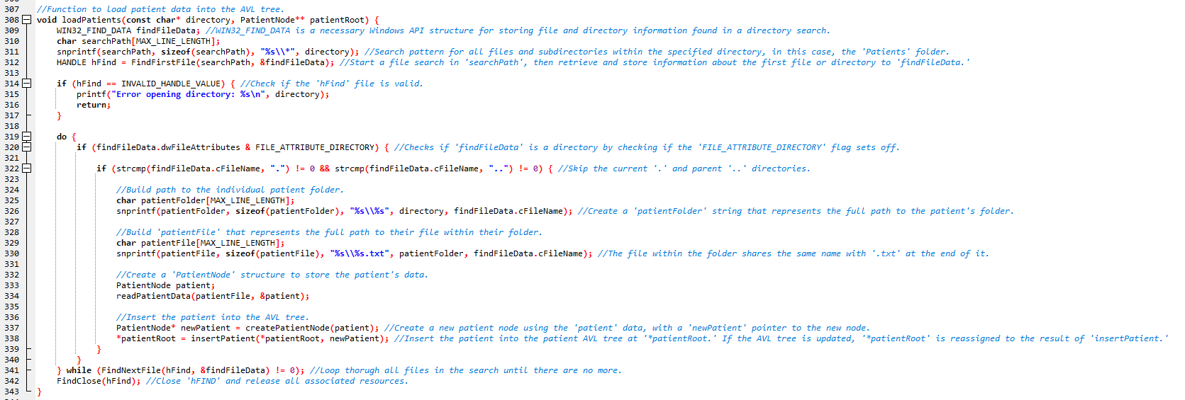
Patient and Employee AVL Tree-Generating Functions (cont)

Slide 11
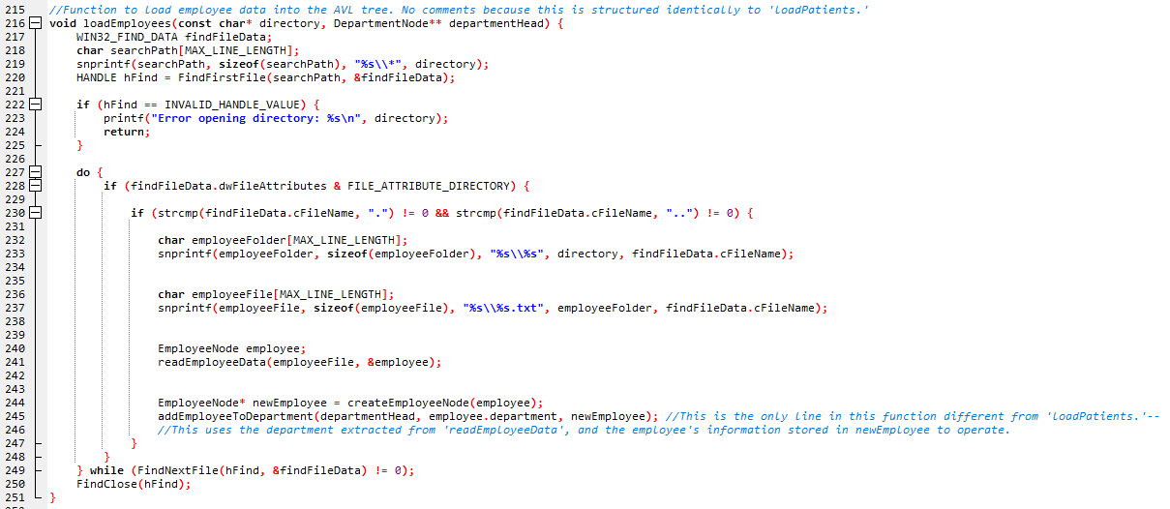
Patient and Employee AVL Tree-Generating Functions (cont)

Slide 12
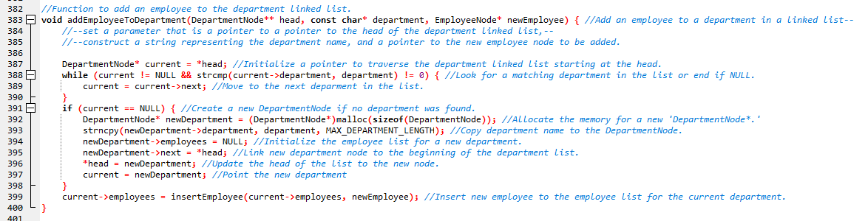
Department-Generating Function

Slide 13
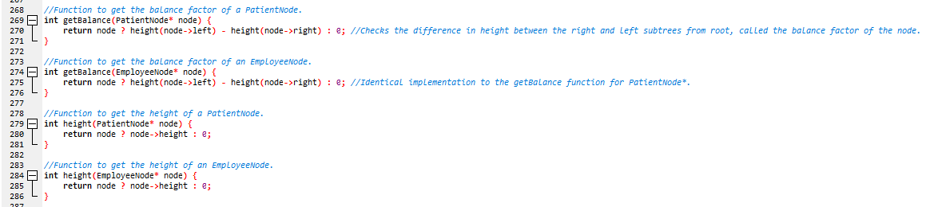
AVL Tree-Balancing Functions

Slide 14
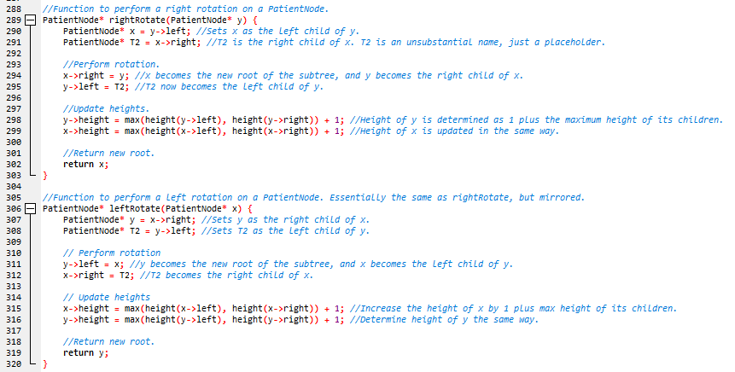
AVL Tree-Balancing Functions (cont)

Slide 15
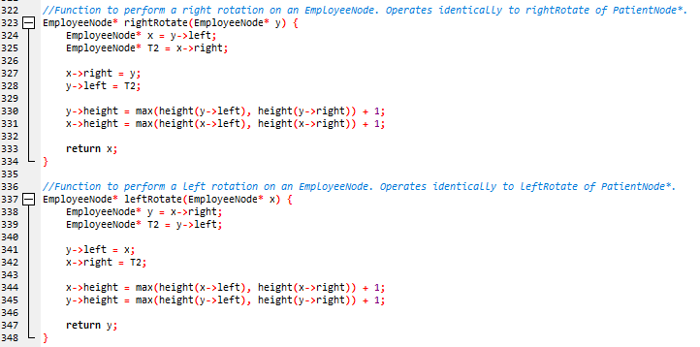
AVL Tree-Balancing Functions (cont)

Slide 16
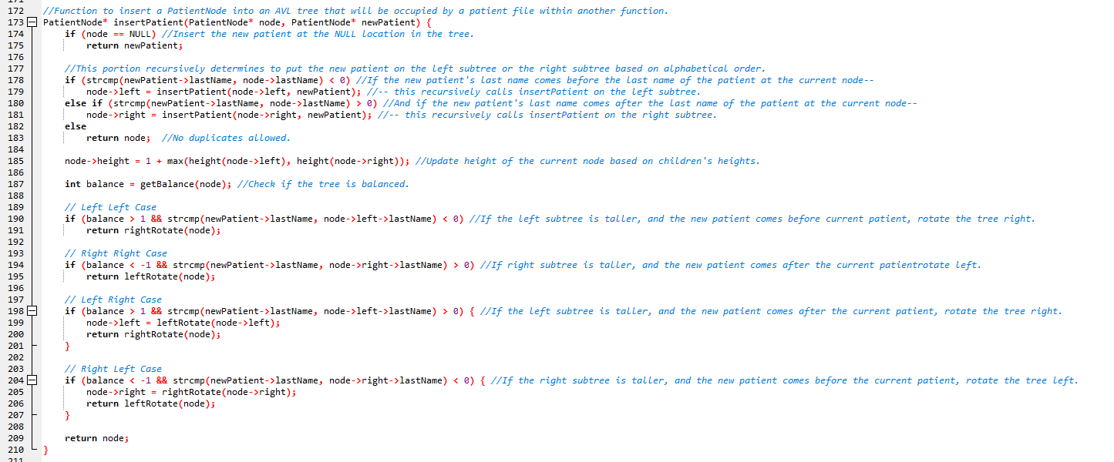
Patient and Employee AVL Tree Functions

Slide 17
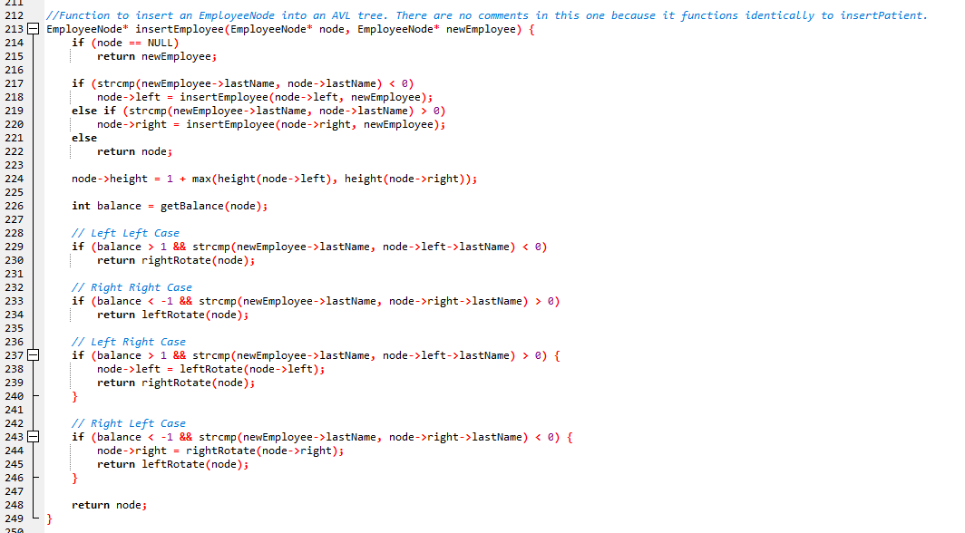
Patient and Employee AVL Tree Functions (cont)

Slide 18
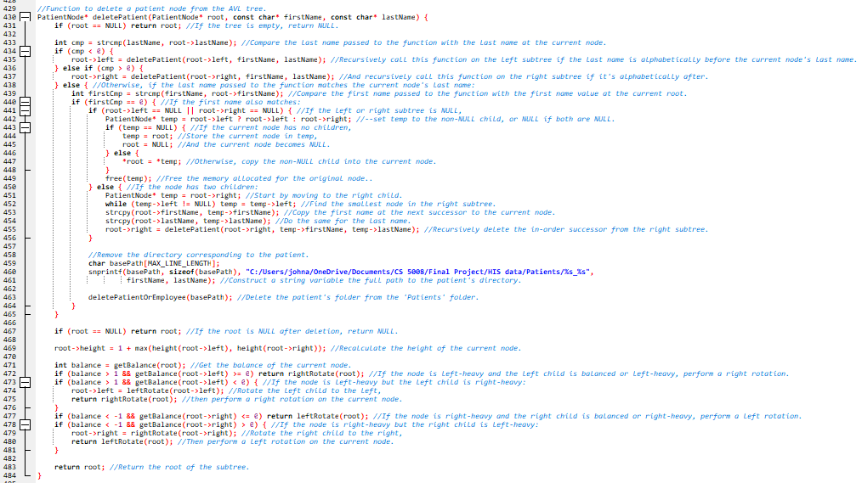
Patient and Employee AVL Tree Functions (cont)

Slide 19
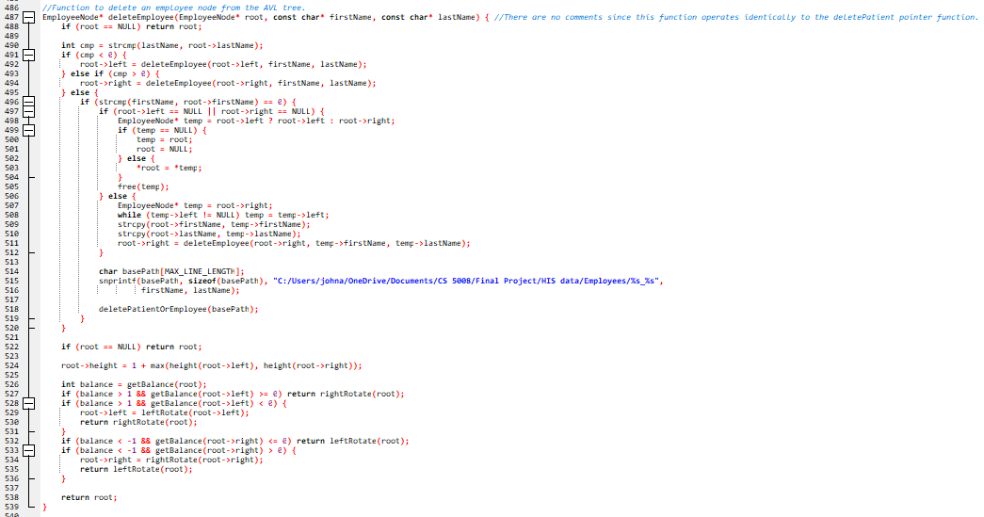
Patient and Employee AVL Tree Functions (cont)

Slide 20
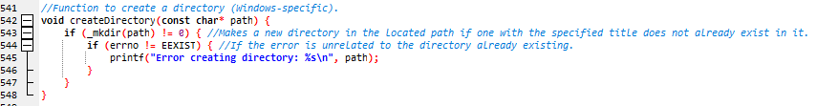
createDirectory Function

Slide 21
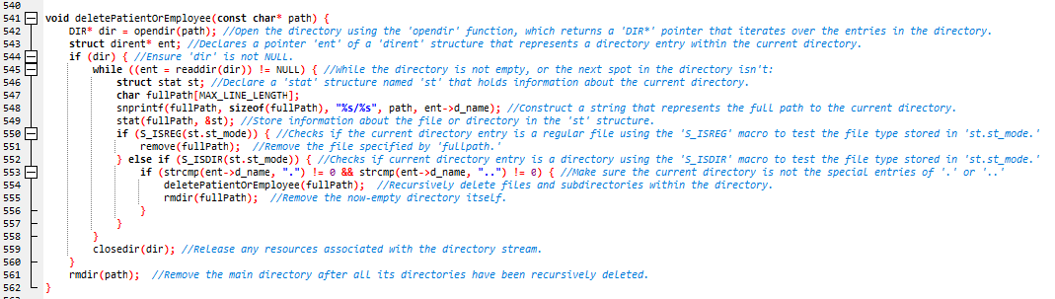
Patient and Employee Operational Functions

Slide 22
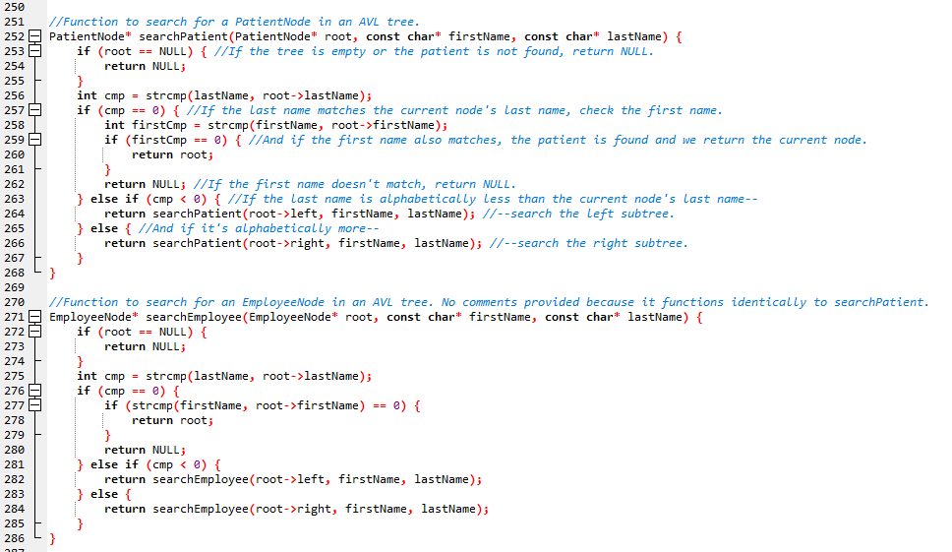
Patient and Employee Operational Functions (cont)

Slide 23
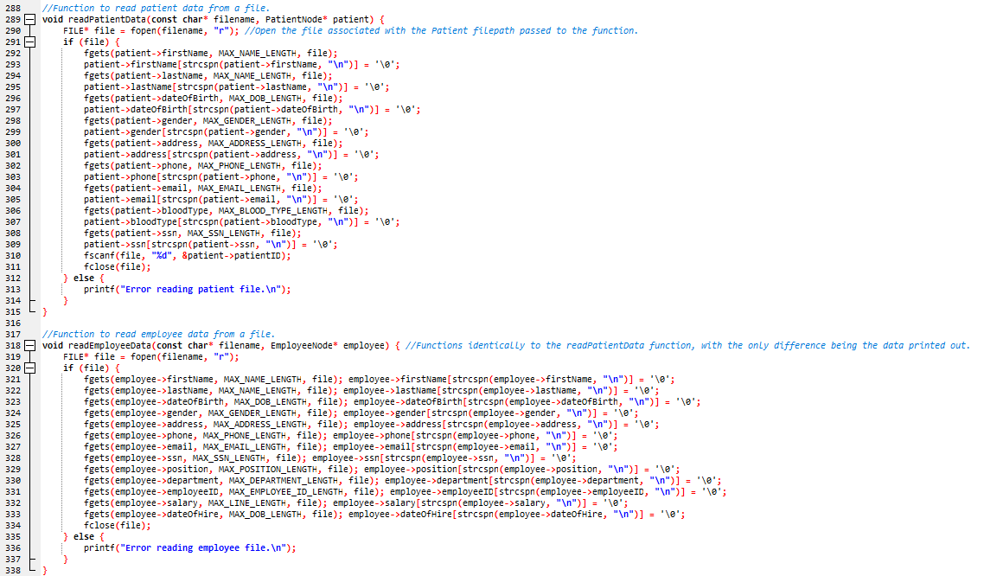
Patient and Employee Operational Functions (cont)

Slide 24
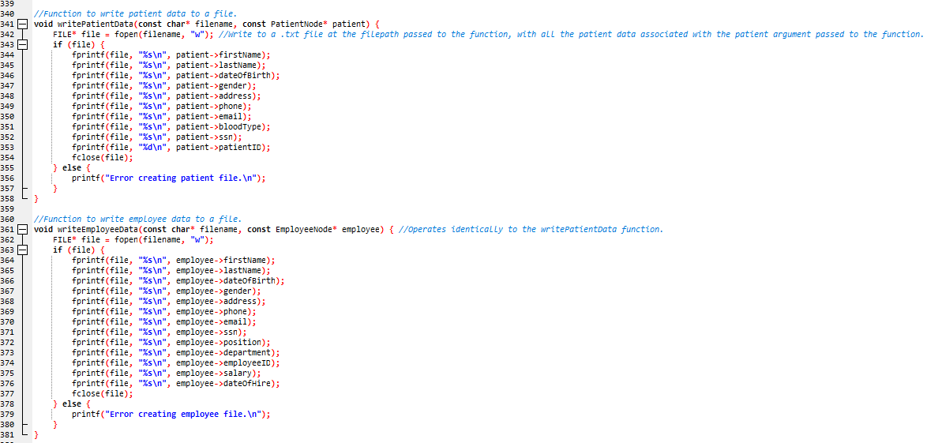
Patient and Employee Operational Functions (cont)

Slide 25
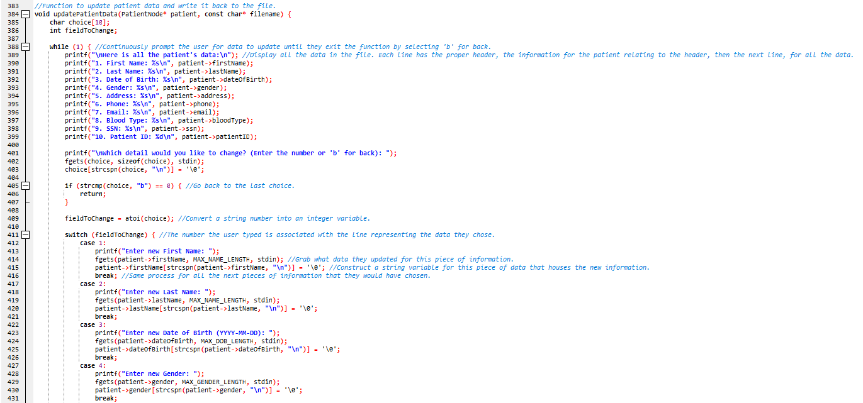
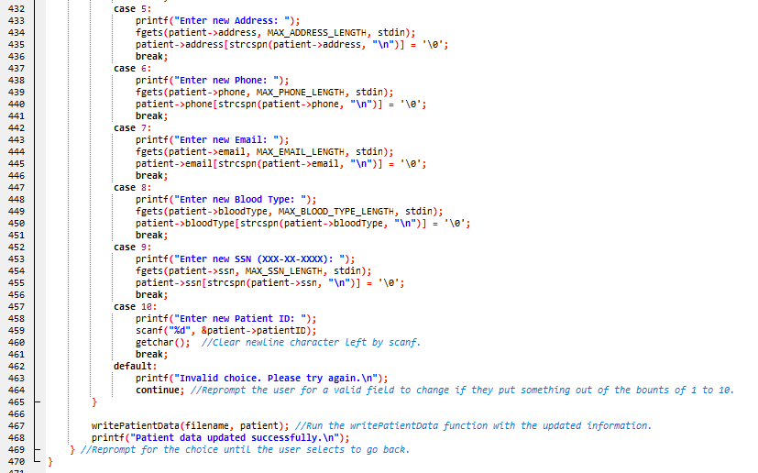
Patient and Employee Operational Functions (cont)

Slide 26
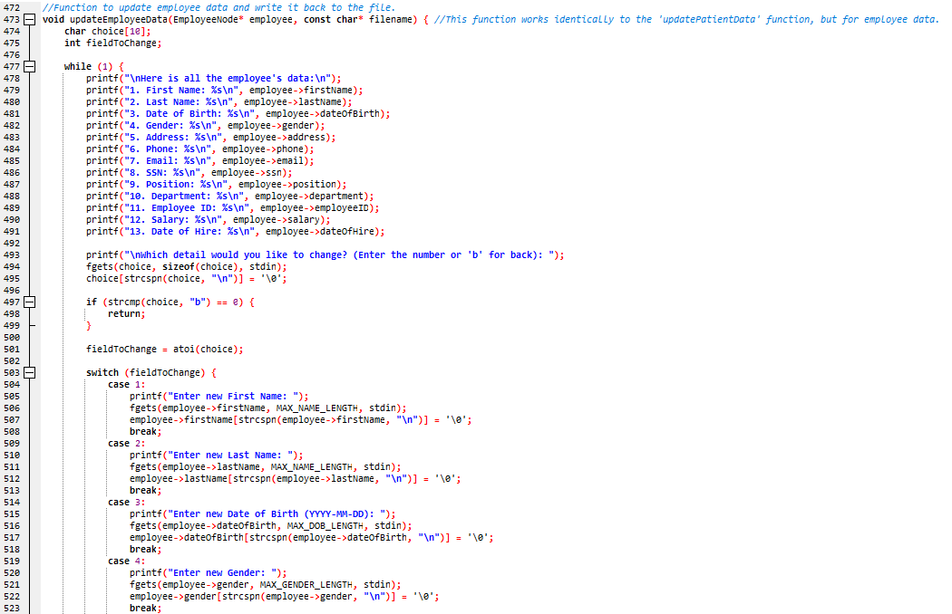
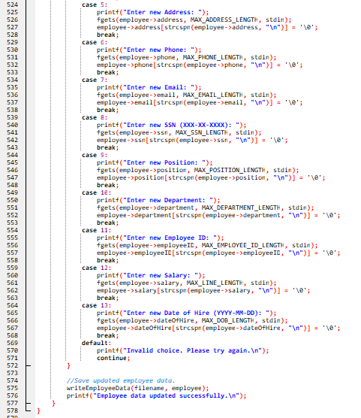
Patient and Employee Operational Functions (cont)

Slide 27
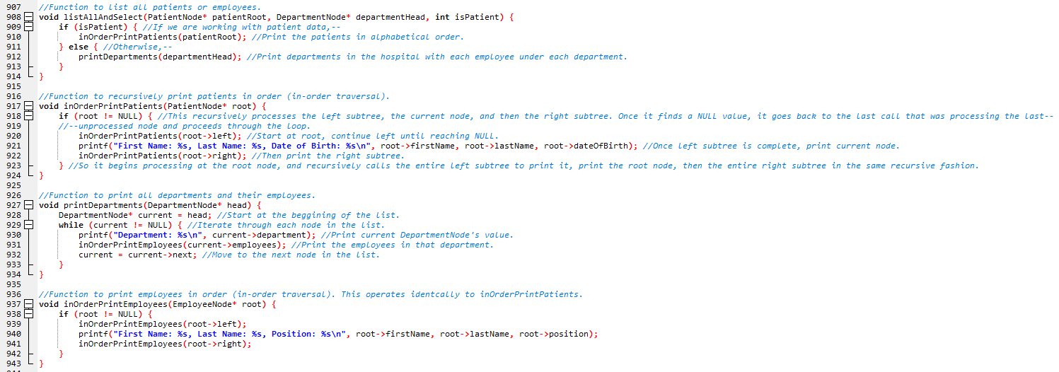
Patient and Employee Operational Functions (cont)

Slide 28
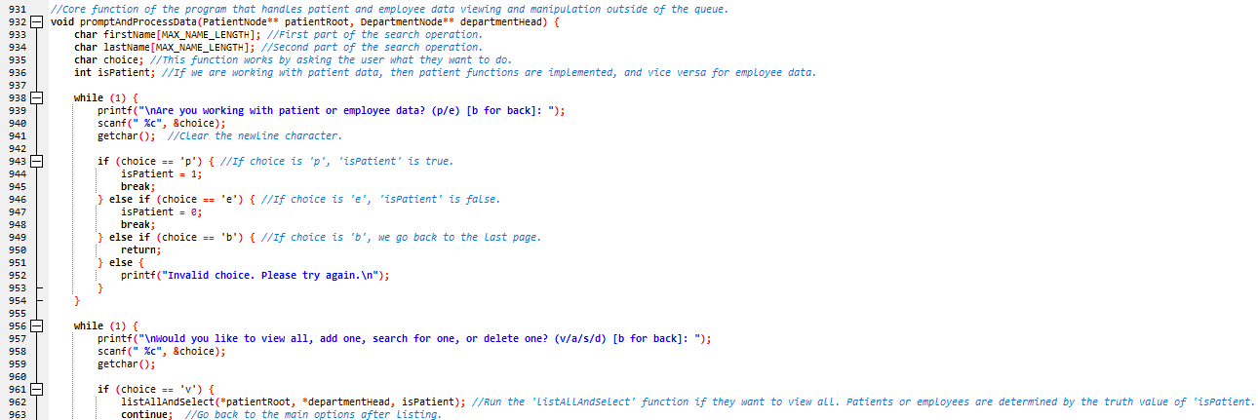
promptAndProcessData Function

Slide 29
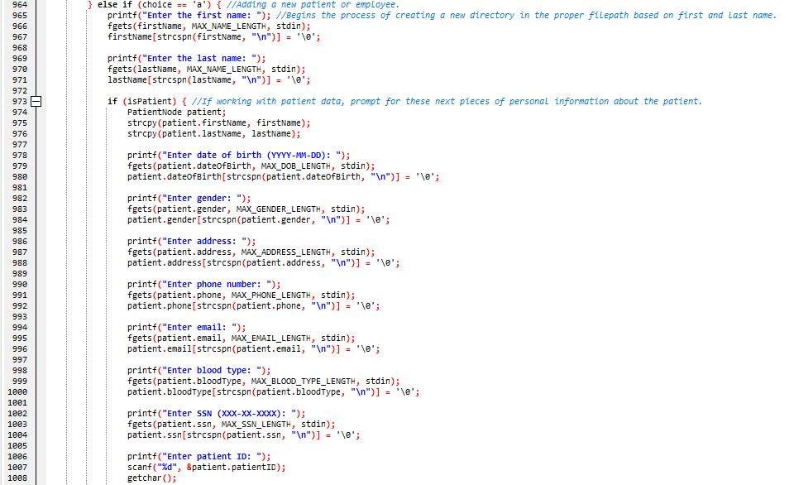
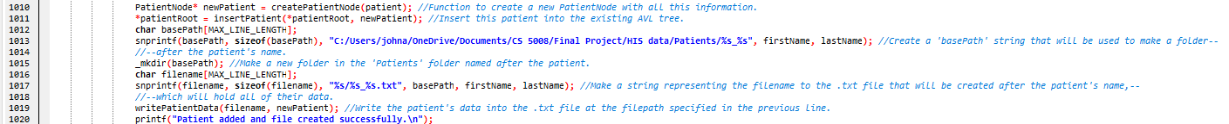
promptAndProcessData Function (cont)

Slide 30
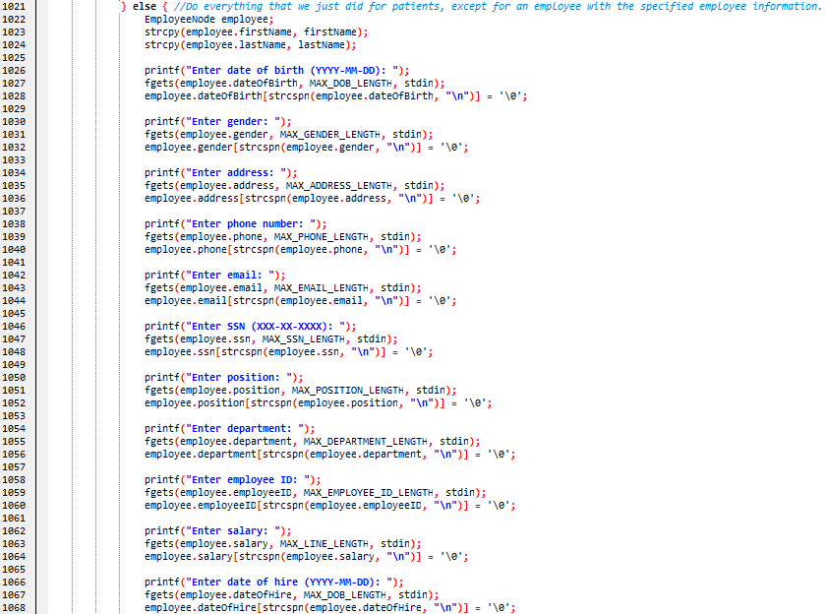
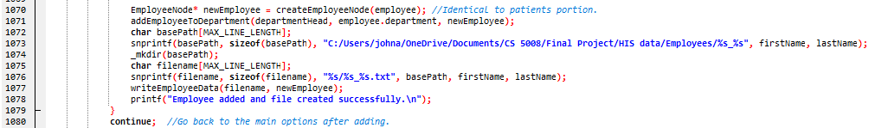
promptAndProcessData Function (cont)

Slide 31
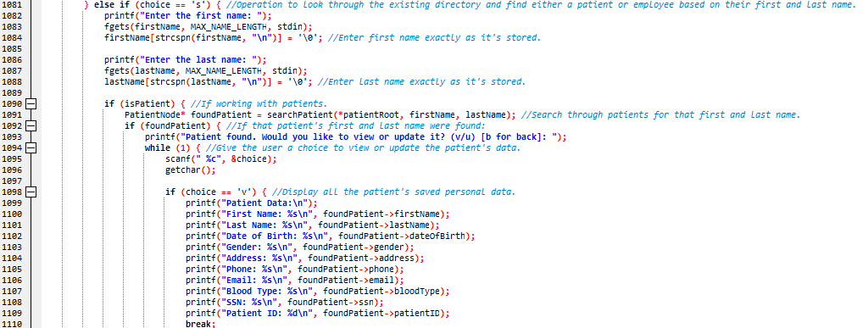
promptAndProcessDataFunction (cont)

Slide 32
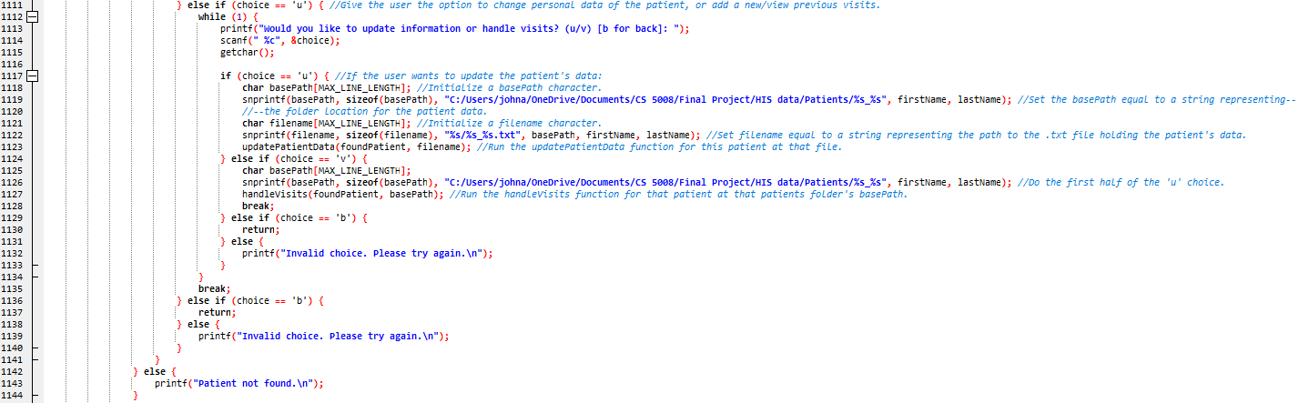
promptAndProcessData Function (cont)

Slide 33
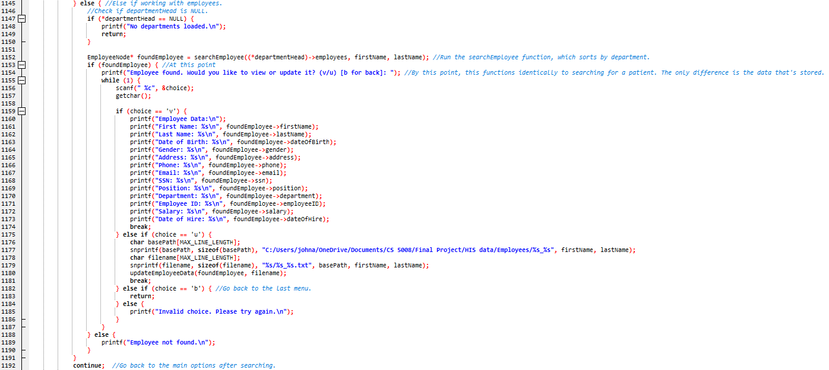
promptAndProcessData Function (cont)

Slide 34
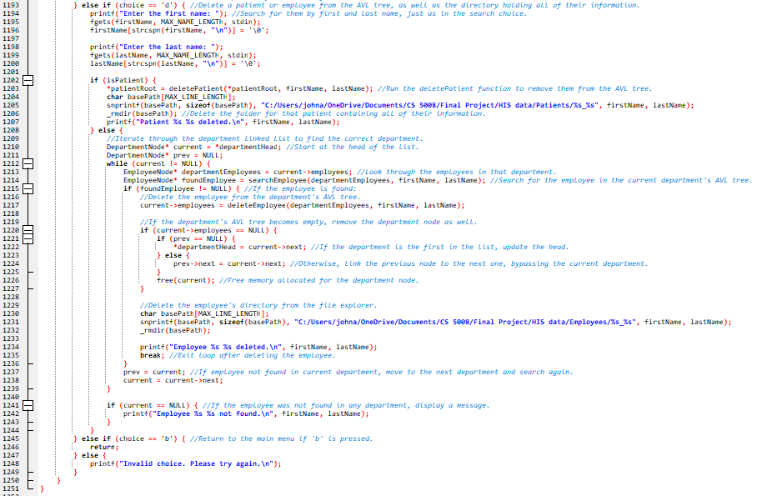
promptAndProcessData Function (cont)

Slide 35
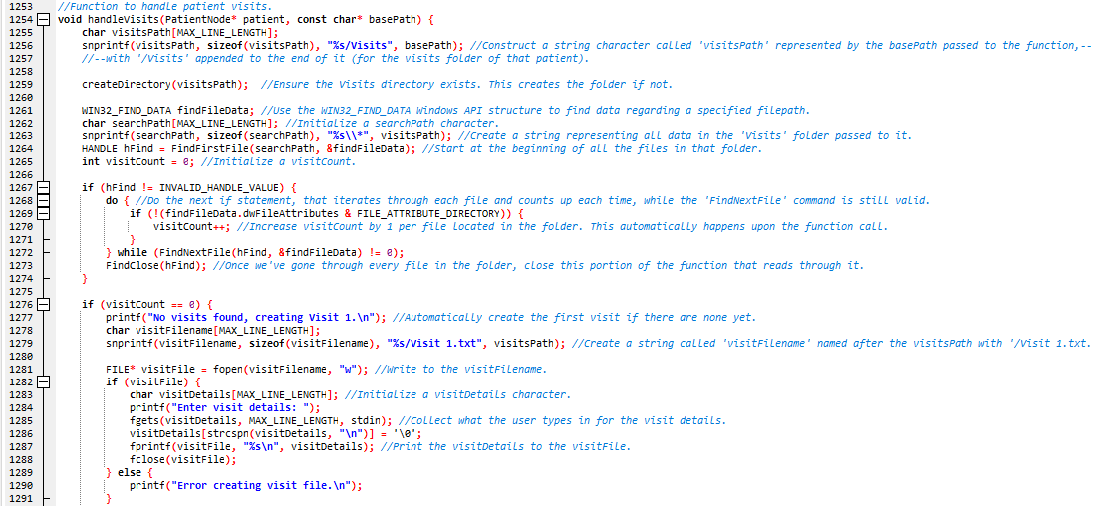
handleVisits Function (cont)

Slide 36
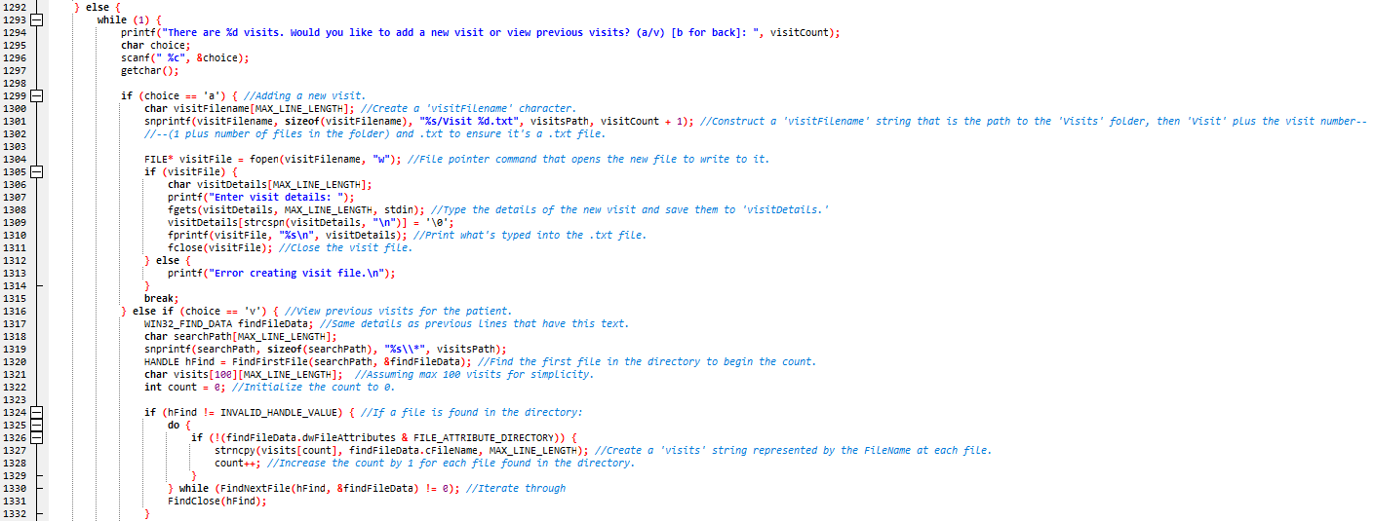
handleVisits Function (cont)

Slide 37
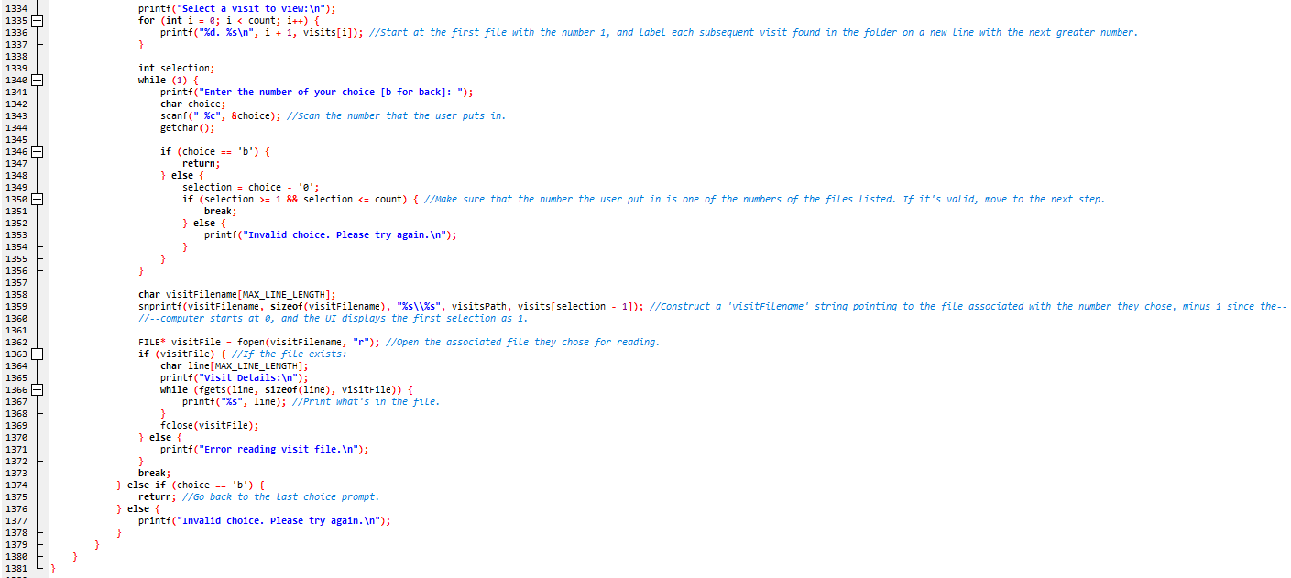
handleVisits Function (cont)

Slide 38
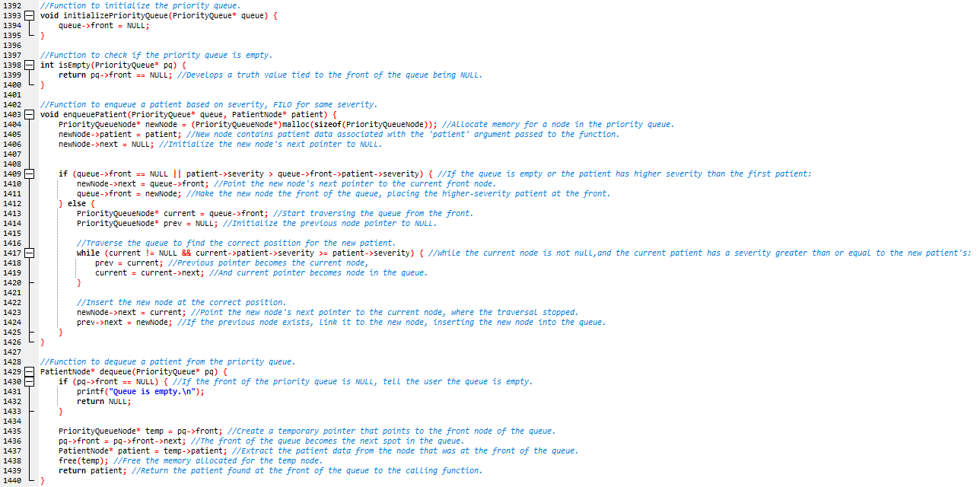
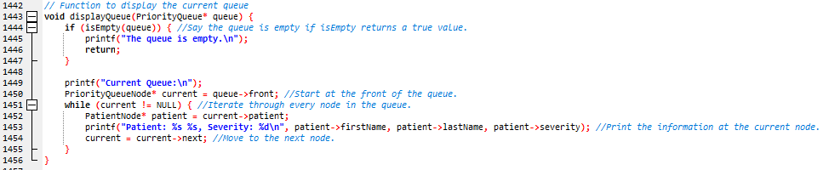
Queue-Processing Functions (cont)

Slide 39
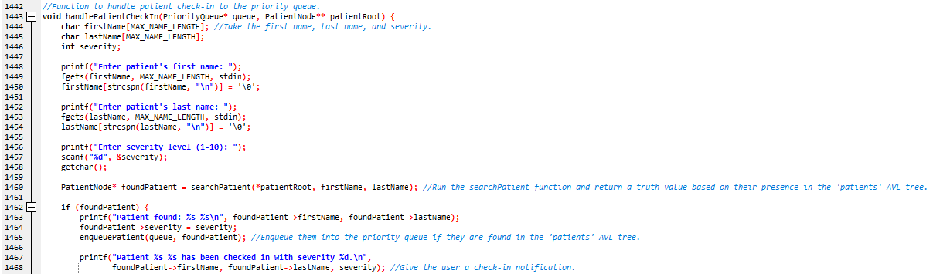
handlePatientCheckIn Function

Slide 40
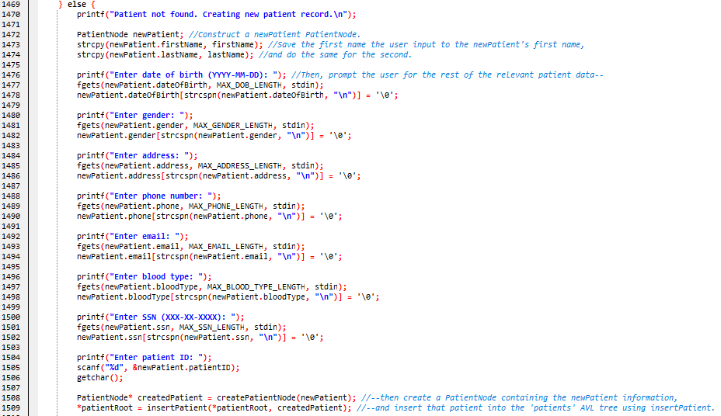
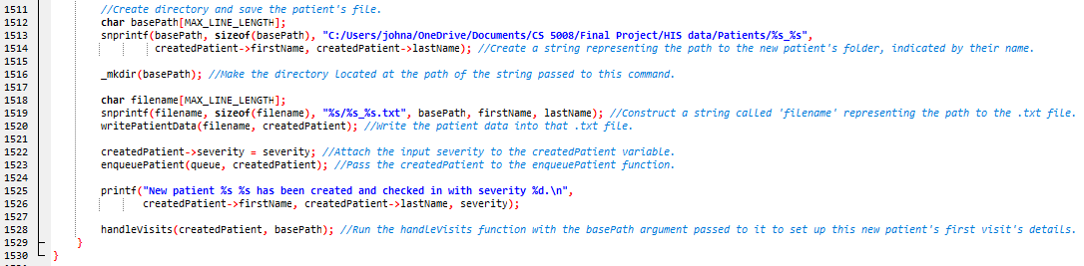
handlePatientCheckIn Function (cont)

Slide 41
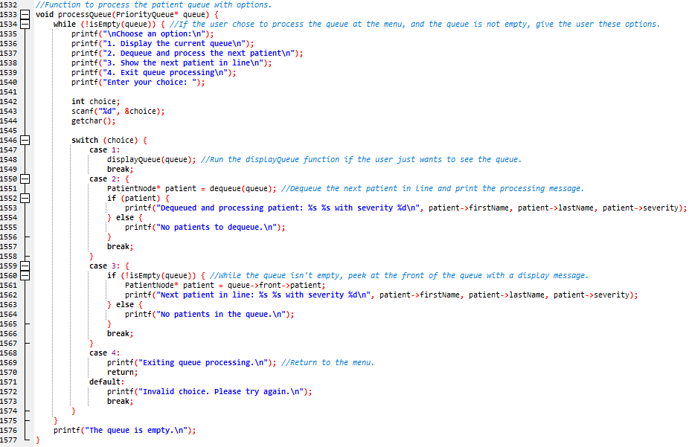
processQueue Function

Slide 42
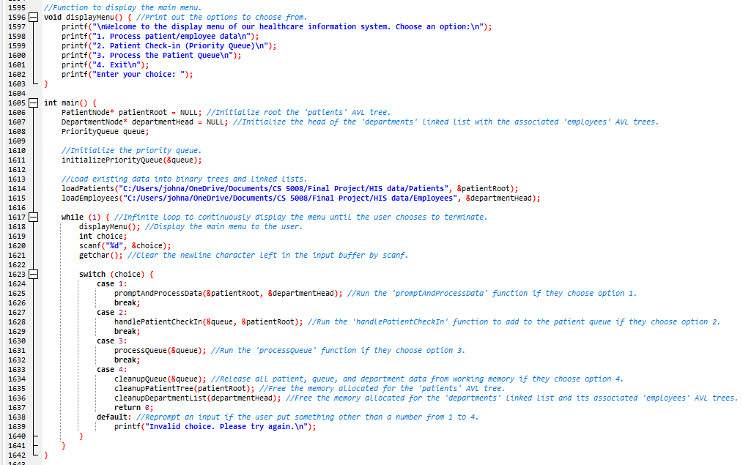
displayMenu and main Functions

Slide 43
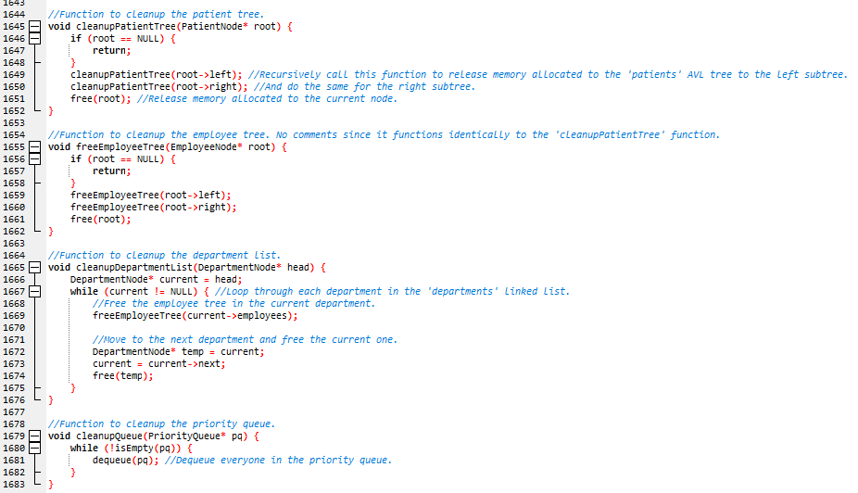
Cleanup/free Functions

Slide 44
Next Steps
Update the ‘departments’ linked list to organize departments alphabetically.
Include operations to assign doctors to patients and make patient information privileged to their doctors.
Consolidate redundant, separate patient and employee functions into single functions.
Change the names of ‘cleanupPatientTree’, ‘cleanupDepartmentlist’, and ‘cleanupQueue’ to ‘freePatientTree’, ‘freeDepartmentList’, and ‘freeQueue’ for clarity and consistency.
Better error handling protocols.
Consider using SQL libraries instead of .txt files for greater data security.
Consider using Red-Black trees instead of AVL trees for faster insertion/deletion functions. AVL trees are better for searching functions.

